Slide 1
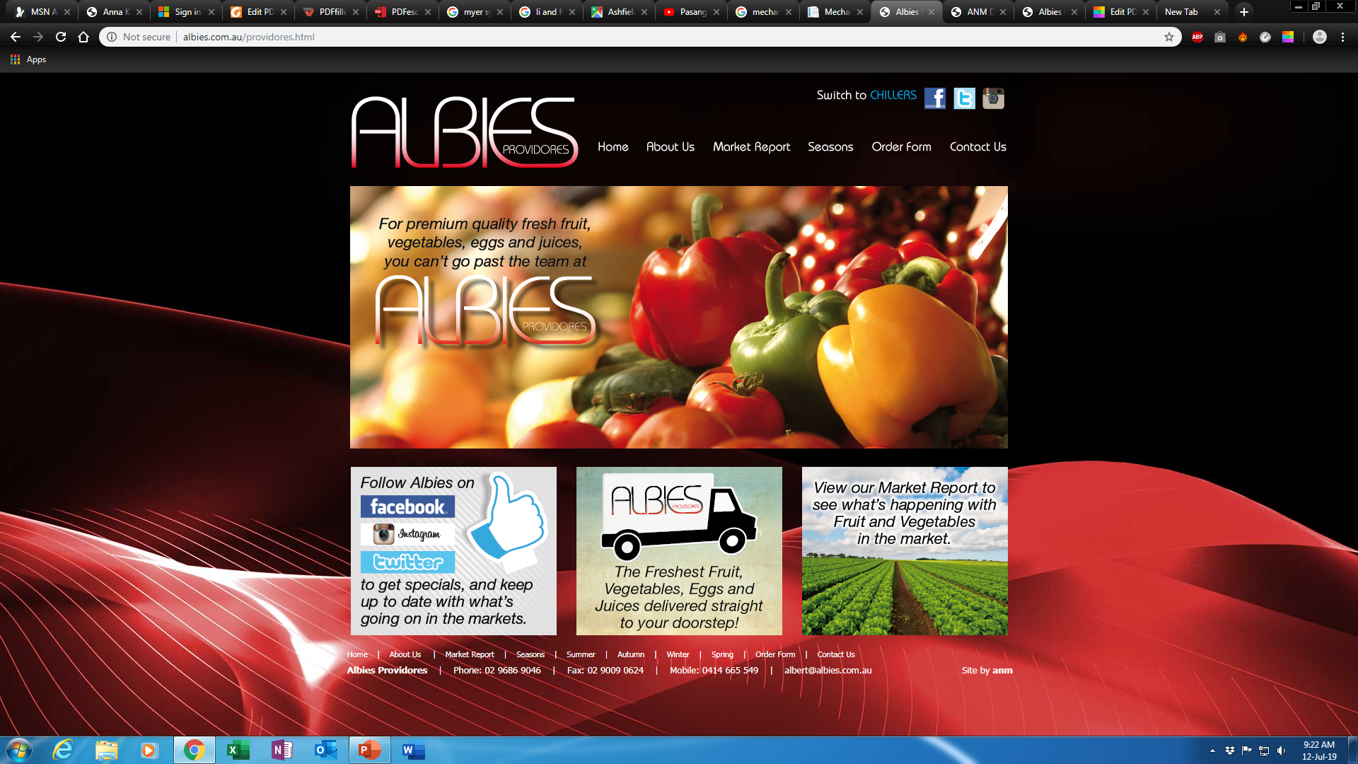
Fruit and Vegetable dealer
Link: http://albies.com.au/providores.html

Slide 2
Target: TO develop a system as this system.
Use as reference: http://albies.com.au/providores.html
Introduction of our customer
Vegetable and fruits suppler.
Meditator/dealer (middle man).
Currently using this system.

Slide 3
1.Basic requirements /demand
(Basic features)
Sliding the background area
(Summer / Autumn / Winter/ Spring ) veg: pic slide

Slide 4
2.Basic requirements /demand
Interference with customer
Sign in /log in / admin
Customer account
Ordering and ordering records (History)

Slide 5
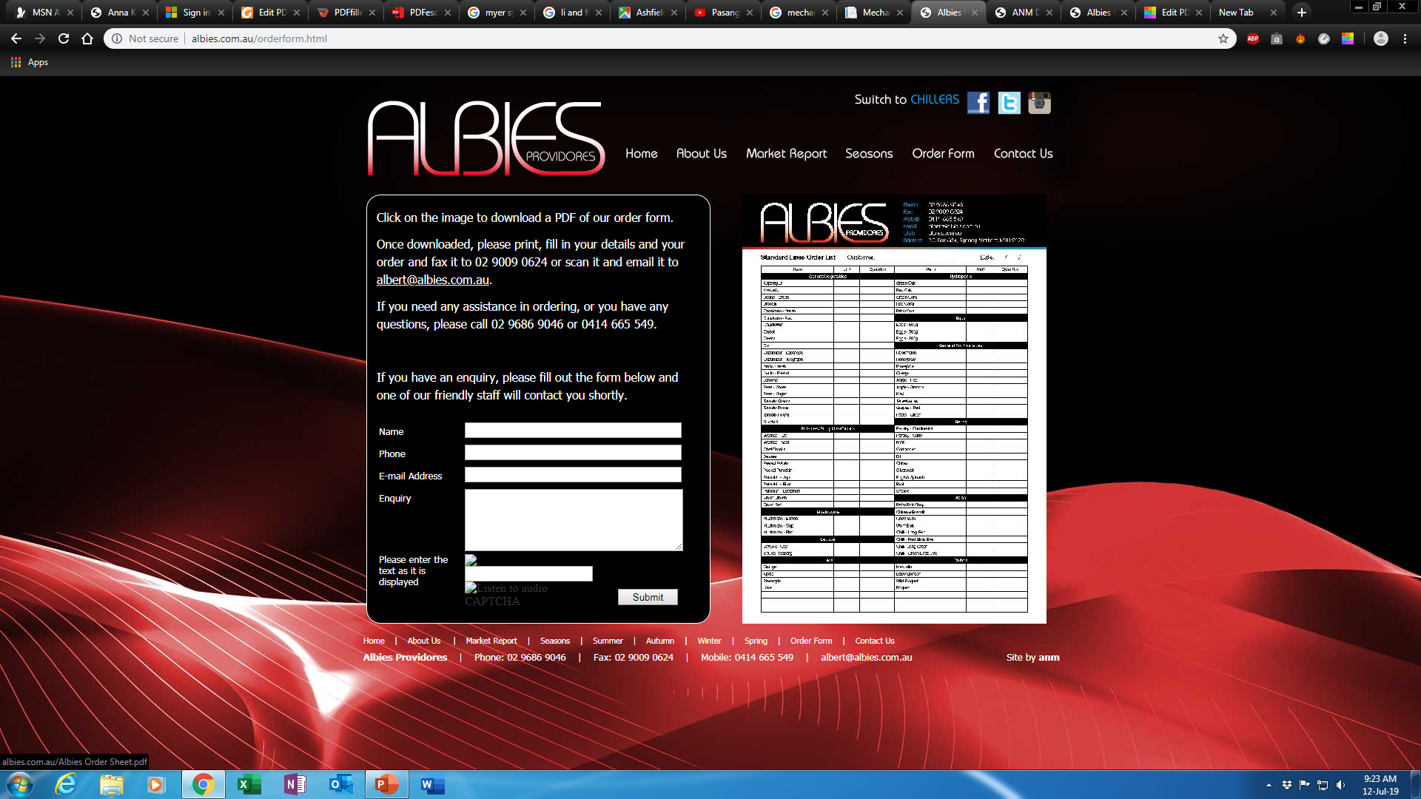
3.Basic requirements /demand
Order form
(Basic features)
Editable: Online editing form(As like SPC-System)
Customizable by admin.
Automatic notification to both admin and customer.

Slide 6
4.Basic requirements /demand
Social media link
Connection with social media when clicking the icons.

